Slide 1

Bank Customer Churn Analysis
Madhusmita
DS- February 2026

Slide 2





Bank Customer Churn Analysis “Turning Data Into Insights To Retain Customers.”
Tools: Excel | SQL | Power BI
Documentation: Word | PowerPoint

Slide 3
“Why do customers leave the bank?”
Problem Statement
The bank is facing a high rate of customer churn, impacting revenue and long-term growth. Understanding customer demographics, behaviors, and risk factors is critical to reduce exits and improve satisfaction.
Agenda / Objective
Analyze customer data (demographics, balances, activity, credit score, exits).
Identify key drivers of churn and retention.
Segment customers by risk and behavior patterns.
Provide actionable insights to improve customer loyalty and service delivery.

Slide 4
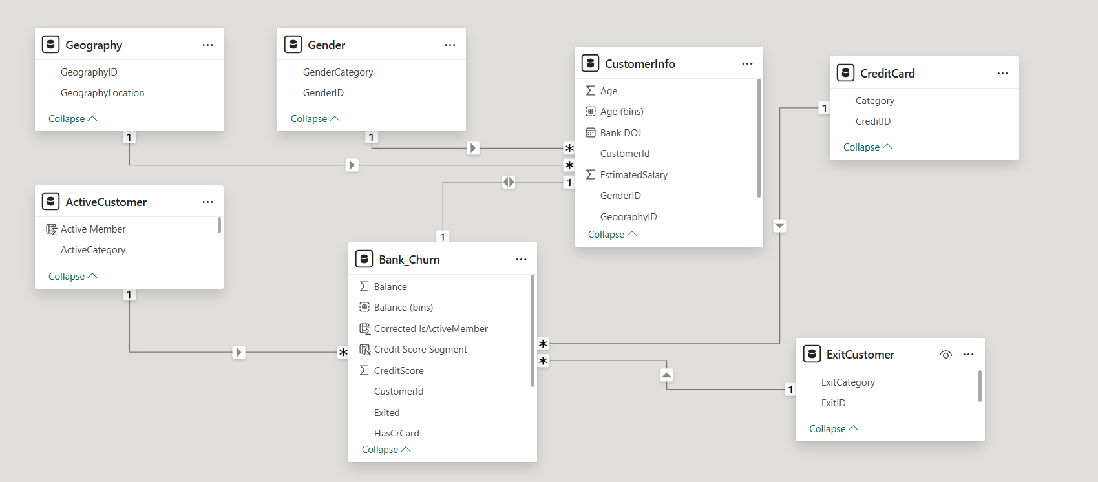
Data Understanding

Slide 5
Data Description
In our data the following details are present :
CustomerId: A unique identifier for each customer.
Credit-Score: A numerical representation of the customer's creditworthiness.
Credit score:
Excellent: 800–850
Very Good: 740–799
Good: 670–739
Fair: 580–669
Poor: 300–579
GeographyID: A numerical identifier that likely corresponds to a geographical location, such as a country or region.
GenderID: A numerical identifier for the customer's gender, where for example, '1' could represent male and '2' could represent female.
Age: The age of the customer.

Slide 6
Tenure: The number of years the customer has been with the bank.
Balance: Current balance in the customer's account.
NumOfProducts: refers to the number of products that a customer has purchased through the bank.
HasCrCard: denotes whether or not a customer has a credit card. This column is also relevant, since people with a credit card are less likely to leave the bank.
1 represents credit card holder
0 represents non credit card holder
IsActiveMember: active customers are less likely to leave the bank (as per the criteria defined by the bank for identifying the activeness).
1 represents Active Member
0 represents Inactive Member
Estimated Salary: as with balance, people with lower salaries are more likely to leave the bank compared to those with higher salaries.
Exited: whether or not the customer left the bank.
0 represents Retain
1 represents Exit
Bank DOJ: date when the Customer associated/joined with the bank.

Slide 7
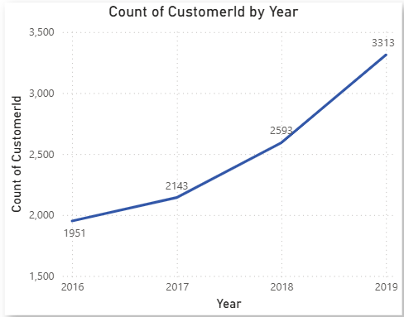
Customers Acquisition over the Years
The bank saw a steady increase in new customers every year.
Consistent growth from 2016 to 2019 shows a positive trend.
2019 recorded the highest number (3,313 new customers).
Growth appears to be accelerating each year, not just steady.
Possible reasons → stronger marketing campaigns, better services, or economic factors.

Slide 8
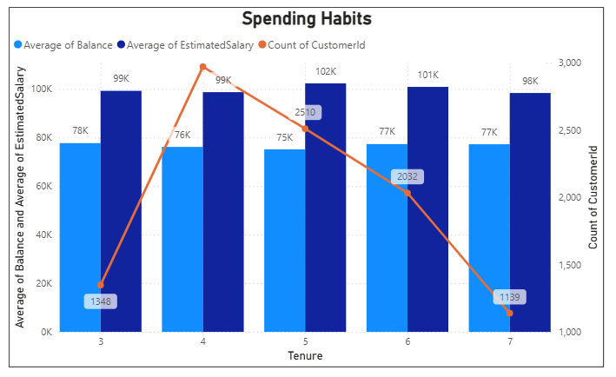
Customer Behavior Analysis
Spending peaks at 4 years of tenure but gradually declines afterward.
Customers with 3–5 years of tenure show higher spending capacity → a valuable group for targeted engagement.
Longer-tenured customers often have stronger financial stability.
However, newer customers should not be ignored → early engagement is key for retention.

Slide 9
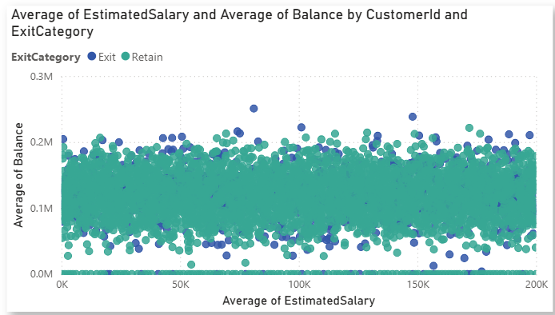
Salary vs. Balance
No clear relationship between customer salary and balance.
Scatter shows salary alone doesn’t strongly drive churn → exits and retentions are spread across all income levels.
Each dot = a customer → 🟢 Retained, 🔵 Exited.
Customers with very high balances (>150K) show slightly higher exit probability (more exits).
Balance is more correlated with churn than salary → mid-to-high balance customers appear more at risk.

Slide 10
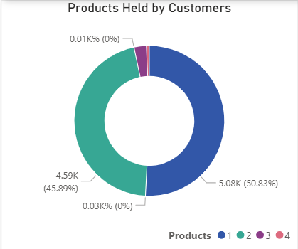
Product Affinity Study
Commonly used Product: Over 90% of the customers uses product 1 and 2.
Cross-Selling Potential: Customers using 1 product may benefit from targeted promotions.
Active Customer Engagement: Focus cross selling efforts on engaging customers.

Slide 11
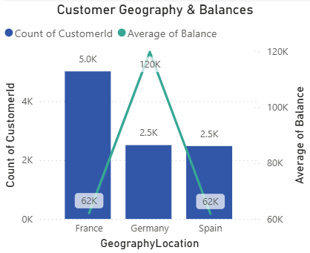
Geographic market trends
France has the highest number of customers, followed by Spain and Germany.
Germany shows the highest churn rate among all regions.
Despite churn, over 80% of customers are retained in France and Spain.
Indicates region-specific strategies may be needed → focus on Germany to improve retention.

Slide 12
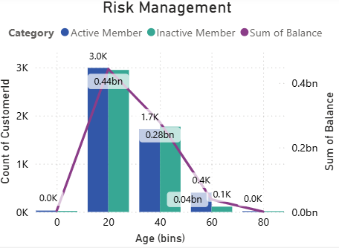
Risk Management Assessment
Inactive members: We can see that in the age bucket of 0-20 and 20-40 the inactive member count is highest suggesting that the younger customers might be at risk of becoming inactive.
Balance Distribution by age: We can also see that the balance is at peak in age 0 -20 and then gradually decreased from 20-40 and much lower when it comes to older age customers.

Slide 13
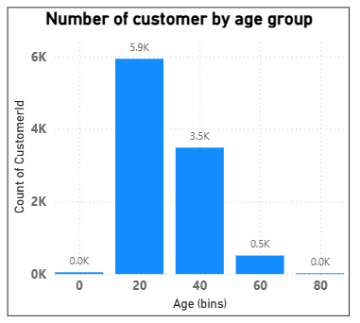
Risk Management Assessment
Risk Concentration by Age: We can see the younger customer (0-20) and (20-40) have the majority of banks total balance.
Therefore, managing risk in these groups is very much important as they didn’t only posses the higher balance but the percentage of inactive members is also high.
While in the oldest age bucket the number of customers is low and the balance is also very low, indicating low risk in financial terms.
Strategy: Since the younger age customers carry the higher balance the efforts to increase engagement and customer retention among inactive younger customer can be beneficial.

Slide 14
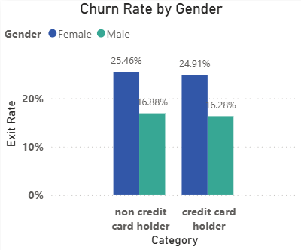
Customer Lifetime Value Forecast
Credit Card Usage and Exit Rates:
Lower exit rates among credit card holders.
Female customers have slightly higher exit rates.
Tenure and Financial Metrics:
Stable financial behavior over time.
Credit Score and Account Balance:
Higher credit scores linked to higher average balances.
Credit score not sole determinant of account balance.

Slide 15
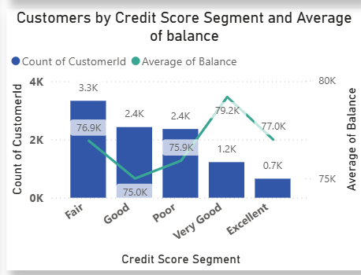
Average balance by credit score
We can see that the Very Good and excellent credit score have the higher average balance.
The average balance does not decreases with the decrease in credit score categories indicating that the customers with lower credit scores can hold sufficient balance.
Therefore it shows that the credit score is not the strong indicator of the balance size.
Strategy: For Good and Fair categories bank should focus on enhancing the relationship and encourage the customer for more product usage.

Slide 16

Churn Count and Average Balance by Geography
Germany shows the highest churn count (~1K) and also the highest average balance (120K), meaning high-value customers are leaving.
France and Spain have lower average balances (~62K each), but churn counts are also notable.
The bank risks losing its most profitable segment in Germany, which could heavily impact revenue.

Slide 17
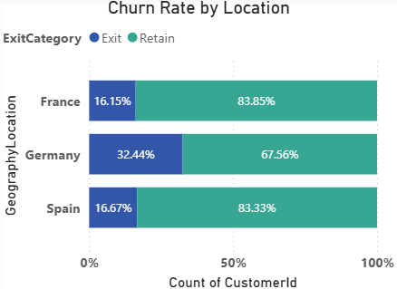
Customer distribution across regions
We can observe that France has the highest numbers of customers followed by Germany and Spain with varying market sizes indicating the potential opportunities for expanding business activities.
Over 80% of the customers remain retained in various regions particularly, in France and Spain.
Where there is higher churn rate and retention strategies are needed therefore.

Slide 18
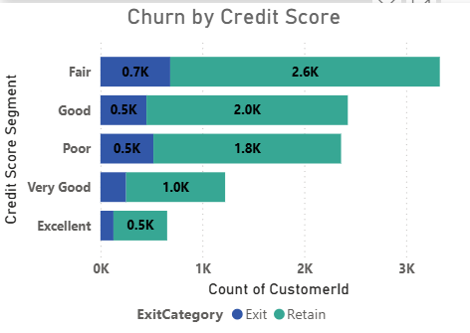
Comparative Analysis
Here, we can see that Fair credit category has the higher exit rate followed by Poor category.
As per the number of customers we can see that in all the credit categories the retention rate is good enough.
Therefore we can say that the credit scores do not have any impact on churn rates.

Slide 19
KEY ISSUES
Imbalanced Data Distribution
Churned customers were significantly fewer than active customers, making it challenging to build balanced predictive models.
Data Quality & Missing Values
Incomplete customer details (e.g., income, spending behavior) restricted deeper insights and required additional preprocessing.
Feature Complexity
Multiple influencing factors (tenure, credit score, geography, age, etc.) made it difficult to isolate the strongest churn drivers.
Regional Variations
Customer behavior varied widely by geography (France, Spain, Germany), requiring tailored analysis instead of a one-size-fits-all approach.
Limited Behavioral Data
Transaction-level or product usage data was not fully available, restricting analysis to demographics and high-level attributes.

Slide 20
Conclusion
Despite the increase in the number of customers over the years, the bank has experienced a consistent churn rate.
Middle age group customers have the highest churn rates, indicating specific retention challenges.
Improving customer engagement, enhancing customer service, and offering competitive products or services are key strategies to reduce churn.
Targeted marketing and personalized offers can help retain customers in critical age and credit score groups.
We have also seen that customer with highest average balance are more likely to churn, in this case targeted marketing and personalized offers can help in retaining those customers.
Overall, by focusing on customer engagement, service enhancement, and targeted strategies for specific customer segments, the bank can reduce churn, improve customer retention, and foster long-term customer loyalty.
Target High-Risk Segments
Develop retention programs for females 50+ and German customers, as they show the highest churn.

Slide 21
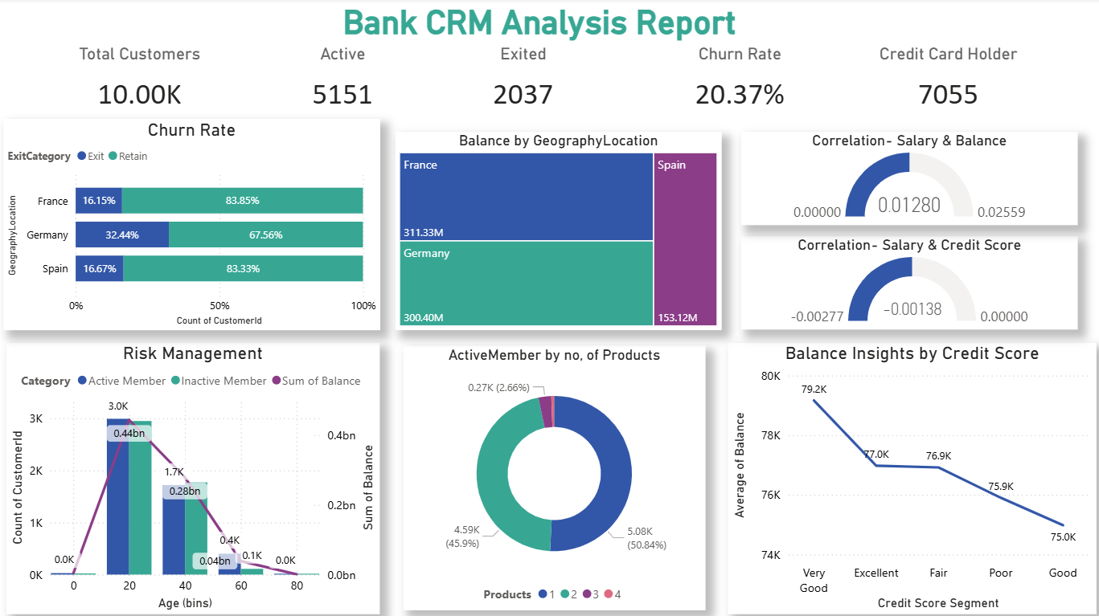

Slide 22
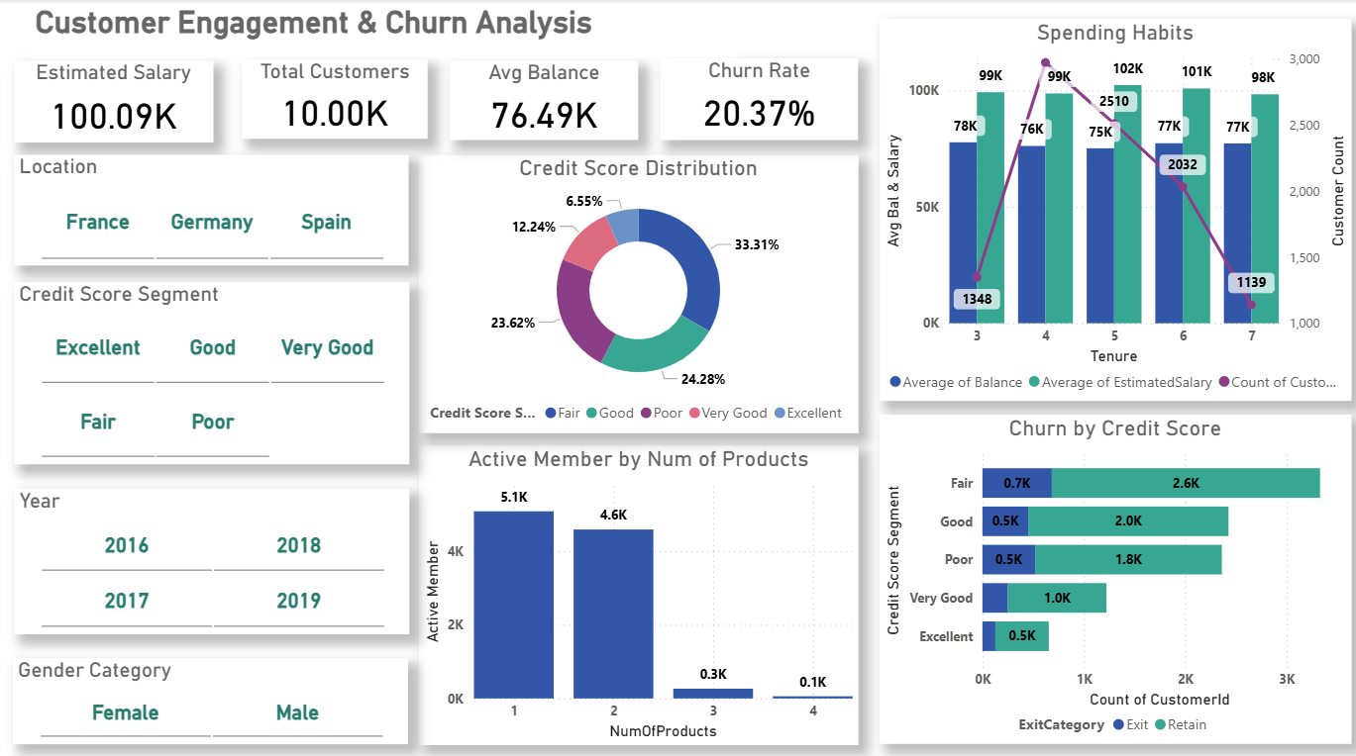

Slide 23
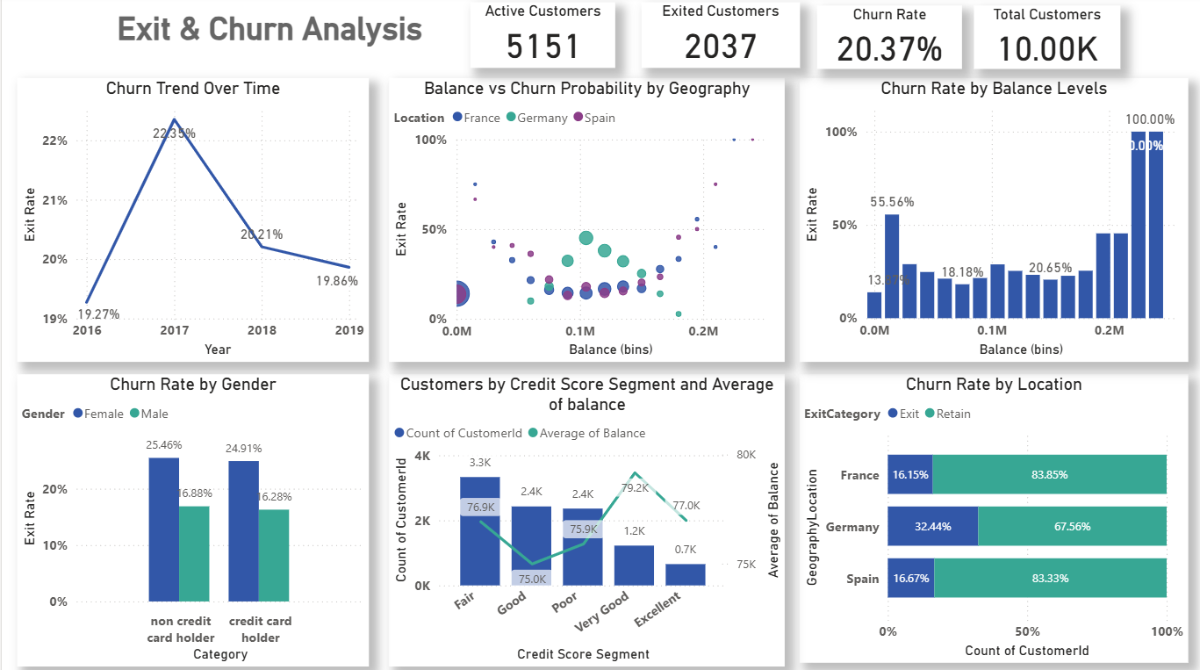

Slide 24


Slide 25
Reference
Data : From Newton School
Applications Used: MS Word, MS Power Point,
MySQL, Power BI.

Slide 26
Thank you

